Slide 1
Case Study Research
Dirk Riehle, Univ. Erlangen
NYT C05
Licensed under CC BY 4.0 International

Slide 2
Agenda
Case study research
Research design
Research execution
Case preparation
Data collection
Data analysis
Evaluation case studies
Quality assurance

Slide 3
1. Case Study Research

Slide 4
Case Study Research
A case is
A contemporary phenomenon in its real-world context
A case study is
An empirical in-depth investigation of a case
Case study research is
Theory building using case studies

Slide 5
Properties of Case Study Research
Case study research
Works even if phenomenon and context are intertwined
Uses multiple sources of evidence in order to triangulate results
Benefits from the prior development of theoretical propositions
The sweet spot are contemporary phenomena, but
Historical cases are possible

Slide 6
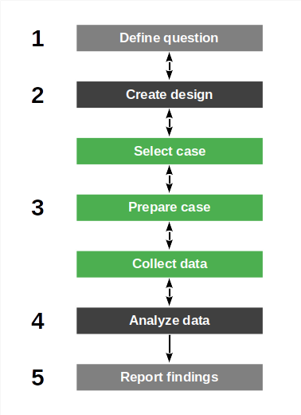
The Case Study Research Process
Case study research is linear yet iterative
Define research question
Create research design
Iterate over
Select case
Prepare case
Collect data
Analyze data
Report findings

Slide 7
Case Study Research Methodologies
General case study research
Yin (2009)
Case study research in software engineering
Runeson et al. (2012)

Slide 8
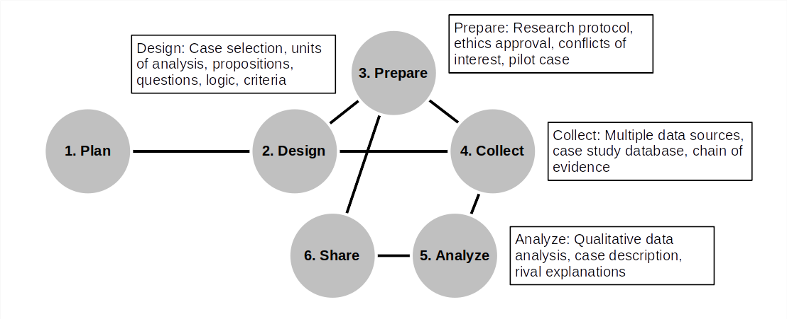
The Case Study Process (Yin, 2009)

Slide 9
NYT (2024) vs. Yin (2009)
NYT (2024) | Yin (2009)
Define question | Plan
Create design | Design
Select case(s) | Design
Prepare case | Prepare
Collect data | Collect
Analyze data | Analyze
Report findings | Share

Slide 10
Types of Case Study Research (Yin, 2009)
Descriptive case study
Collects, analyses, and presents cases for documentation purposes
Exploratory case study
Investigates cases for theory building and hypothesis generation
Explanatory case study
Tries to establish causal relationships between constructs

Slide 11
2. Research Design

Slide 12
Case Study Research Design
Components of a case study research design
The research questions
The propositions, if any
The unit(s) of analysis
The data-to-proposition linking logic
The interpretation criteria

Slide 13
Example Exploratory Research Question
Problems in Product-Line Engineering (PLE) [1]
What are current problems in product line engineering and why?
Purpose is building an early theory
[1] Riehle et al. (2016): Inner source in platform development.

Slide 14
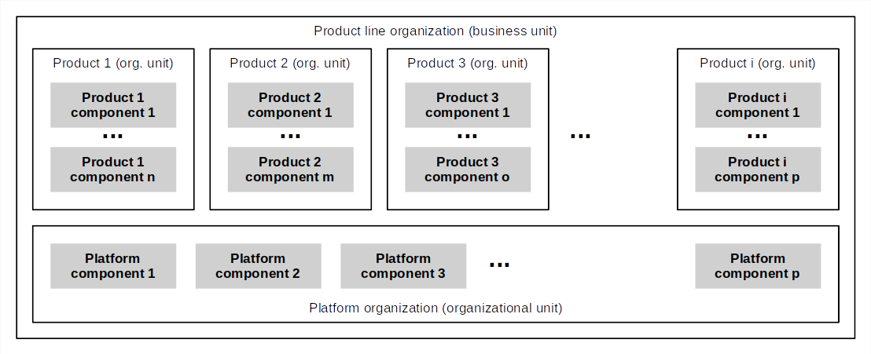
Product-Line Engineering

Slide 15
Unit of Analysis
A unit of analysis is
A construct being analyzed
Units of analysis can be
Tangible (e.g. people, products)
Intangible (e.g. theoretical constructs like group dynamics)
In the simplest case (no pun intended), the case is the unit of analysis

Slide 16
Example of (Potential) Units of Analysis
Problems in product-line engineering
The overall business unit
The product organizational units
The platform organizational unit
The business unit leader
Engineering managers
Architects / developers

Slide 17
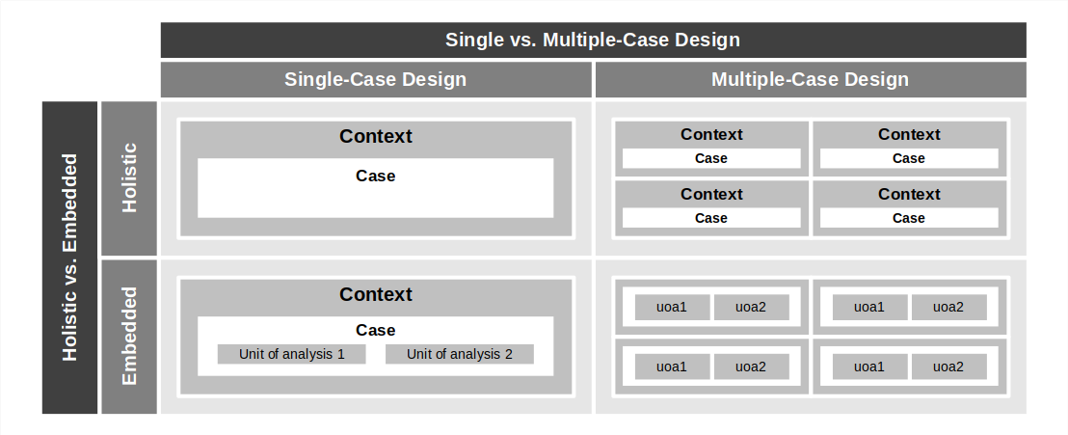
Dimensions of Case Study Research Design 2 / 2

Slide 18
Single-Case Case Study Research
Types of single-case case study research
The typical (representative) case
Special cases
The critical case
The unique / extreme (rare and/or particularly interesting) case
The revelatory case
The longitudinal case

Slide 19
Multiple-Case Case Study Research
Case replication
Theoretical replication to contrast and extend findings
Literal replication to strengthen findings

Slide 20
Example of Multiple-Case Case Study Research
 | Case 1 | Case 2 | Case 3
Domain | Business | Healthcare | Telco carrier
Age of platform | > 10 years | > 10 years | > 10 years
Number of developers | > 500 developers | > 500 developers | > 500 developers
Distributed (yes/no) | No (same campus) | Yes (same metro area) | No (same campus)
Developer population | Homogeneous | Homogenous | Homogenous
Organization | Profit / cost center | Profit / cost center | Profit / cost center
Age of company | > 20 years | > 20 years | > 20 years
Size of company | > 1000 developers | > 10000 developers | > 10000 developers
Case sponsor | Business owner | Platform organization | Internal consulting group

Slide 21
Example Process Plan
Case 1 → case 2 → case 3
Incremental build-out

Slide 22
3. Research Execution

Slide 23
Case Study Research Execution
Iterate over
Select case
Prepare case
Collect data
Analyze data

Slide 24
Case Selection
Select case from process plan
As long as saturation is not reached or
No cases are left

Slide 25
Example case selection
Problems in product-line engineering
Case 1 → case 2 → case 3

Slide 26
Case Preparation
Prepare as laid out in research protocol
Inform participants
Prepare for data collection
Build case database
Refine as necessary given specific case

Slide 27
Example Case Preparation
We prepared
Site visits
Interview guides
Documents gathering

Slide 28
Data Collection
Perform data collection as planned in protocol, for example,
Direct observation (“shadowing”)
Participant observation
Participant interviews
Additional materials gathering

Slide 29
Example Data Collection
 | Case 1 | Case 2 | Case 3
Date | 2012 | 2013 | 2013
No. interviews | 11 | 6 | 4
No. workshop notes | 5 | None | 3
Additional materials | Yes | Yes | Yes

Slide 30
Examples of Additional Materials
Case materials
Letters
Calendars
Meeting minutes
Workshop notes
Admin. documents
Progress reports
Written reports
…
Archival materials
Public records
…
Physical artifacts
Works of art
Tools and devices
Furniture
…

Slide 31
Data Analysis
Data analysis depends on the type (and hence purpose) of the case studies
Descriptive case study research
Little to no analysis
Exploratory case study research
QDA for theory building
Explanatory case study research
QDA linking data to propositions

Slide 32
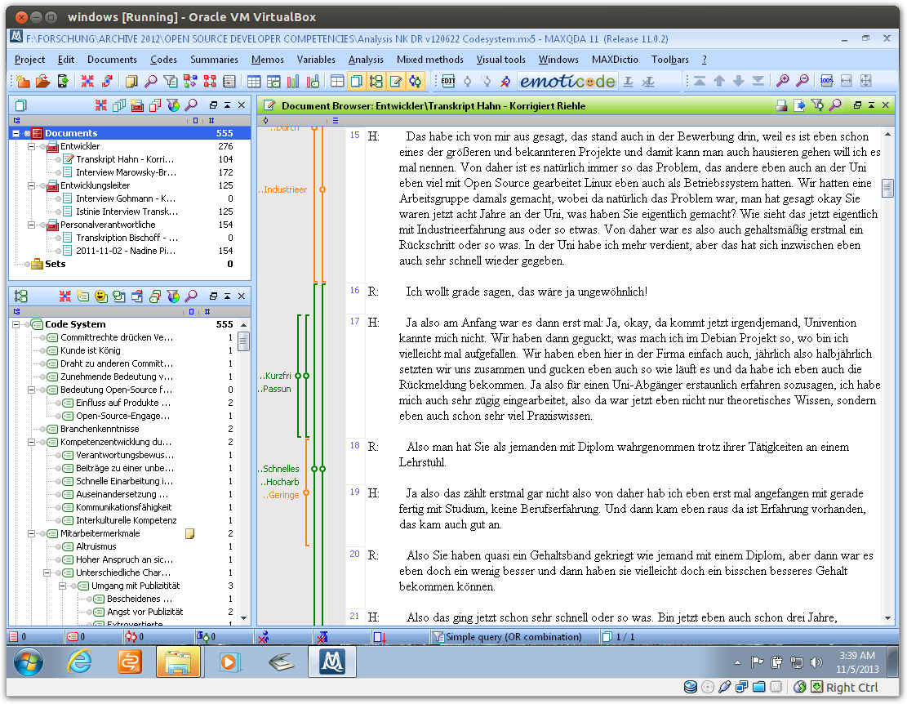

Slide 33
4. Explanatory Case Studies

Slide 34
Explanatory Case Study Research
Tries to identify causal connections between constructs
By qualitatively evaluating propositions
Thereby evaluates proposed theory
By poking holes into propositions

Slide 35
Guidelines for Explanatory Case Study Research (Yin, 2009)
Use data triangulation (evidence from multiple types of sources)
Use method triangulation (different methods on same data)
Emphasize rival theories and explanations

Slide 36
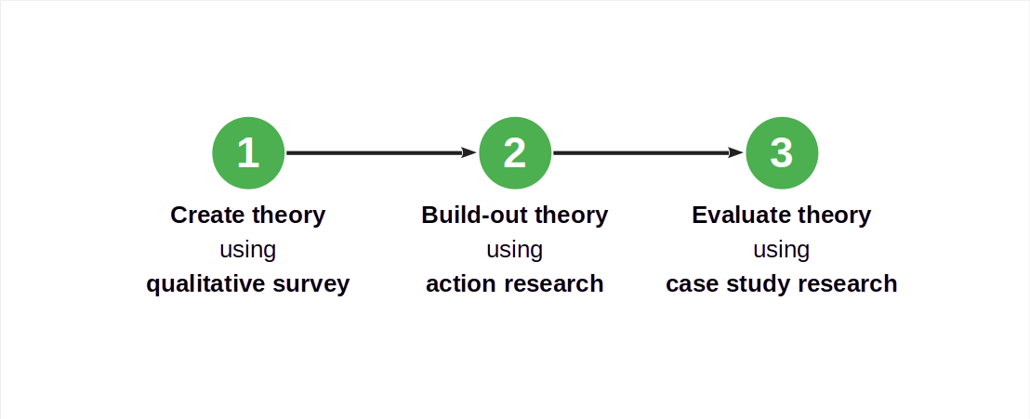
Case Study Research in a Larger Research Design

Slide 37
Exploration vs. Explanation Revisited
Exploratory case study research prefers
Theoretical replication to go broad
Explanatory case study research prefers
Literal replication to go deep

Slide 38
Example Explanatory Case Study Research
Inner source platform development [1]
Is inner source more effective for building platforms? If so, why?
[1] Current, ongoing research by https://oss.cs.fau.de

Slide 39
Example Multiple-Case Design With Replication Logic
 |  | Inner source approach (IS)
 |  | Unit of analysis 1, case 1 | Unit of analysis 1, case 2 | Unit of analysis 1, case 3
Dedicated organization approach (DO) | Unit of anal- ysis 2, case 1 | [1] Direct comparison of IS and DO from case 1 | [a] Cross-case 1 + 2 IS analysis | [b] Cross-case 1 + 3 IS analysis
 | Unit of anal- ysis 2, case 2 | [x] Cross-case 1 + 2 DO analysis | [2] Direct comparison, [i] Replication of case 1 | Not planned
 | Unit of anal- ysis 2, case 3 | [y] Cross-case 1 + 3 DO analysis | Not planned | [3] Direct comparison, [ii] replication of case 1 + 2
Direct comparison = [1], [2], [3] Cross-case unit-of-analysis comparisons = [a], [b], and [x], [y] Replication of case analyses = [i], [ii]

Slide 40
5. Quality Assurance

Slide 41
Quality Criteria According to Yin (2009)
Internal validity
“Do pattern matching”
“Do explanation building”
“Address rival explanations”
“Use logic models”
External validity
Construct validity
Reliability
…
I am confused. Maybe this applies to case study research that is trying to pose as theory validation research (hypothesis testing). However, this will never meet the rigor of controlled experiments; it is better to use the quality criteria of naturalistic inquiries. [DR]

Slide 42
Quality Criteria Following Runeson et al. (2012)

Slide 43
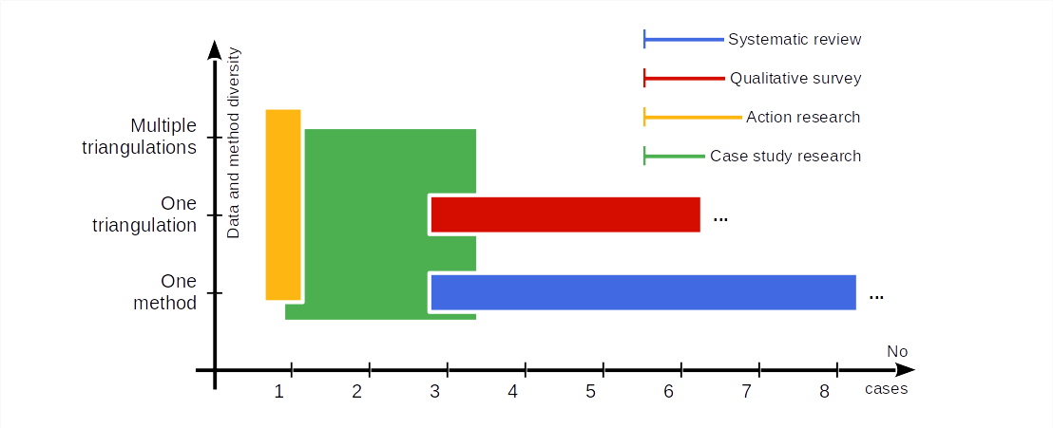
Research Methodologies in Comparison

Slide 44
Thank you! Any questions?
dirk.riehle@fau.de – https://oss.cs.fau.de
dirk@riehle.org – https://dirkriehle.com – @dirkriehle

Slide 45
Legal Notices
License
Licensed under the CC BY 4.0 International license
Copyright
© 2012, 2023, 2024 Dirk Riehle, some rights reserved

